Slide 1
Task Analysis and Implementation
Presented by :
Tal Sahar
Asaf Galili

Slide 2
Introduction
This presentation details the implementation of two models, APPModel and AttributionModel, for analyzing network-related datasets. Each task involved distinct goals:
- APP Task: Focused on network application profiling.
- Attribution Task: Targeted at traffic attribution.
Both tasks required data exploration, insight extraction, and model integration.

Slide 3
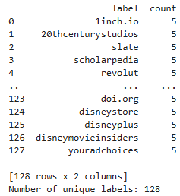
APP - Data Exploration
The APP task involved analyzing a dataset with 640 entries and 112 features:
Insights:
The target variable, label, had 128 unique values, indicating a diverse classification problem.

Slide 4
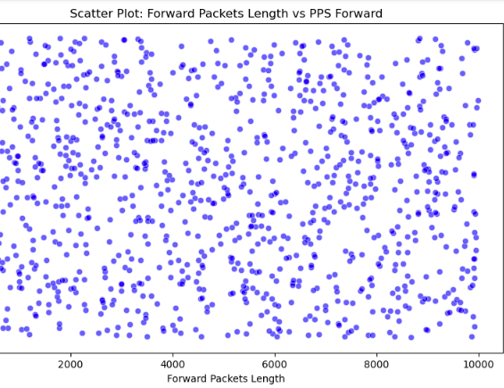
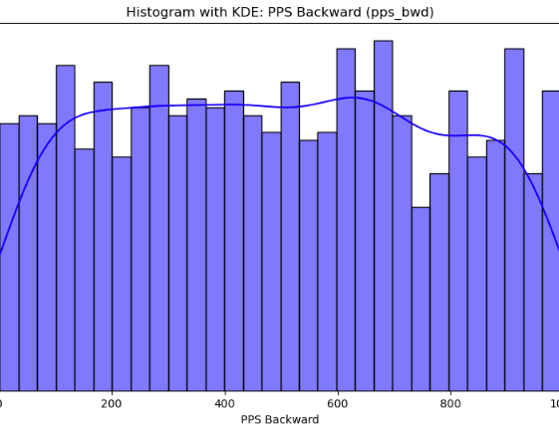
Variability in features like fwd_packets_length and pps_fwd suggests different traffic patterns.
Uniform Distribution:
The points are spread fairly evenly across the plot.
High variance in pps_bwd highlights potential outliers.
The consistent spread across the range of pps_bwd values highlights a high variability in the backward packet rates.
This variability could represent different traffic patterns or types of network behavior.

Slide 5
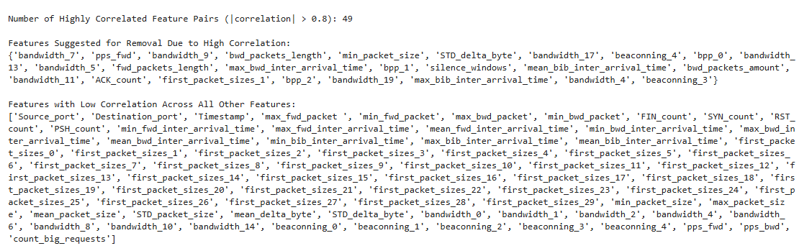
Correlation analysis revealed clusters of highly correlated features.

Slide 6
APP Task Implementation
Training/Testing :train.csv and test.csv for training and validation.
Feature Engineering: Applied normalization to handle the wide range of numeric feature values.
Add Features Method: Derived features like packet counts and lengths enhanced performance.
Modeling: Both Gradient Boosting and Random Forest classifiers were implemented to predict the label
Evaluation: Accuracy and confusion matrices were computed to assess performance.

Slide 7
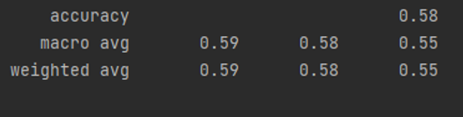
Test Reasults

Slide 8
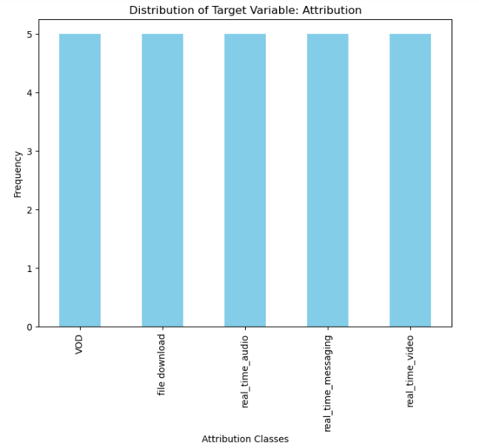
Attribution Task: Data Exploration
The Attribution task used a dataset with 25 entries and 112 features:
Compact dataset required careful handling to avoid overfitting.
Correlation analysis highlighted strong relationships among features
Target variable, attribution, had 5 unique values.
.

Slide 9
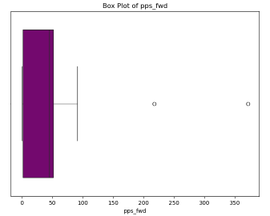
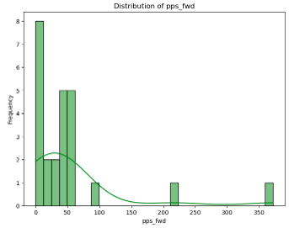
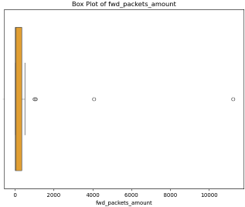
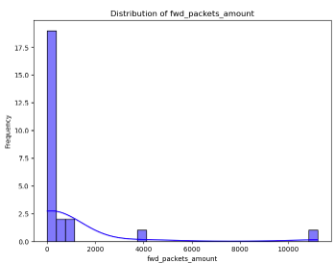
Features like fwd_packets_amount and pps_fwd exhibited variability.
High Variance:
Both features (fwd_packets_amount and pps_fwd) show significant variability.
The presence of extreme outliers suggests that traffic patterns might differ significantly in certain scenarios.
Skewness:
Both features are skewed toward smaller values, meaning that most traffic falls within low values of packets and rates.

Slide 10
Attribution Task Implementation
Data Preprocessing: One-hot encoding and scaling.
Add Features Method: Derived features like packet ratios and rates improved classification.
Modeling: A Random Forest classifier was chosen, leveraging its robustness for small datasets and its ability to handle feature importance effectively while minimizing overfitting..
Cross-Validation: A 5-fold cross-validation approach was used to evaluate model performance during training.
Evaluation: Used accuracy and class-specific metrics.

Slide 11

Test Reasults

Slide 12

Summary
- APPModel: Focused on diverse traffic pattern classification.
- AttributionModel: Targeted precise attribution with limited data.
- Both models utilized tailored preprocessing and modeling techniques.

